Slide 1
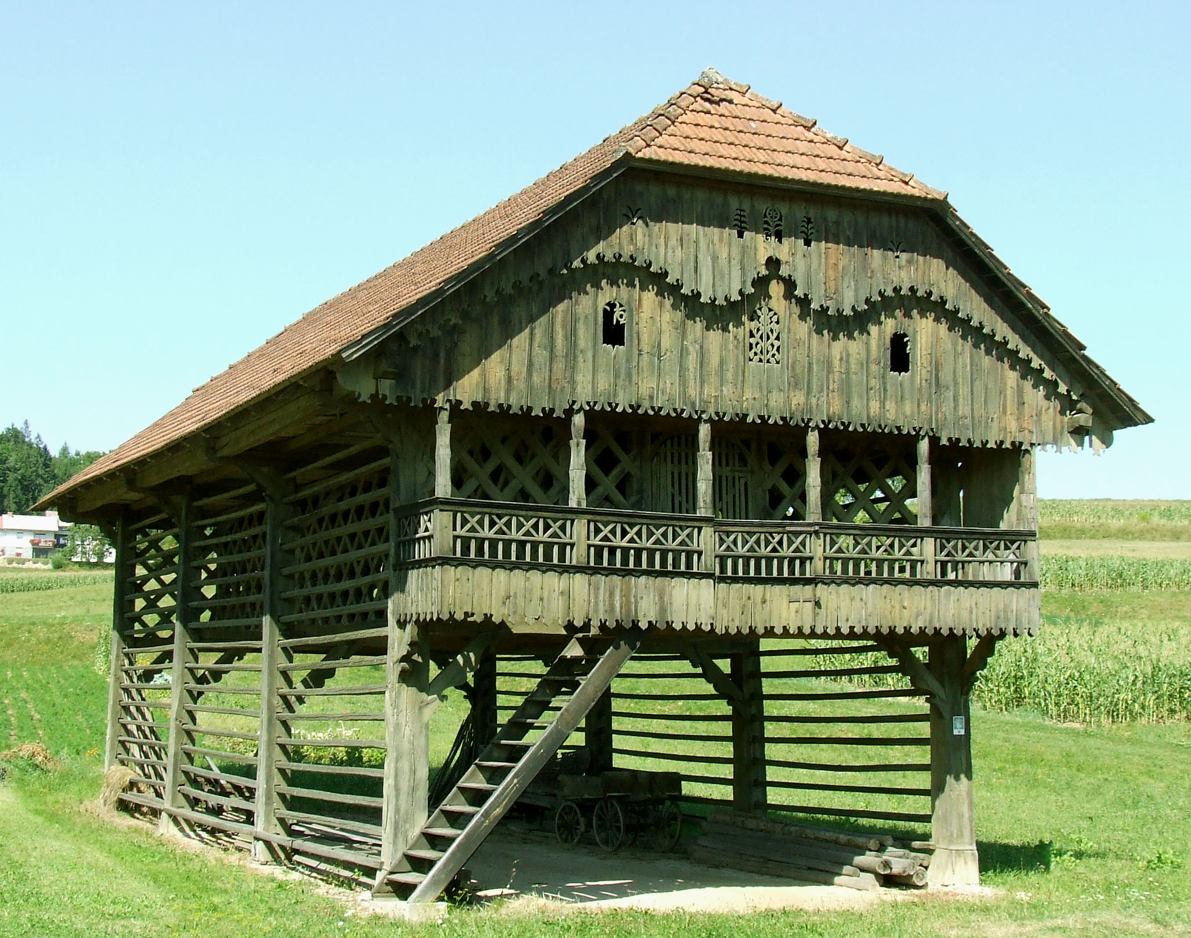
KOZOLEC- HAYRACK
.

Slide 2
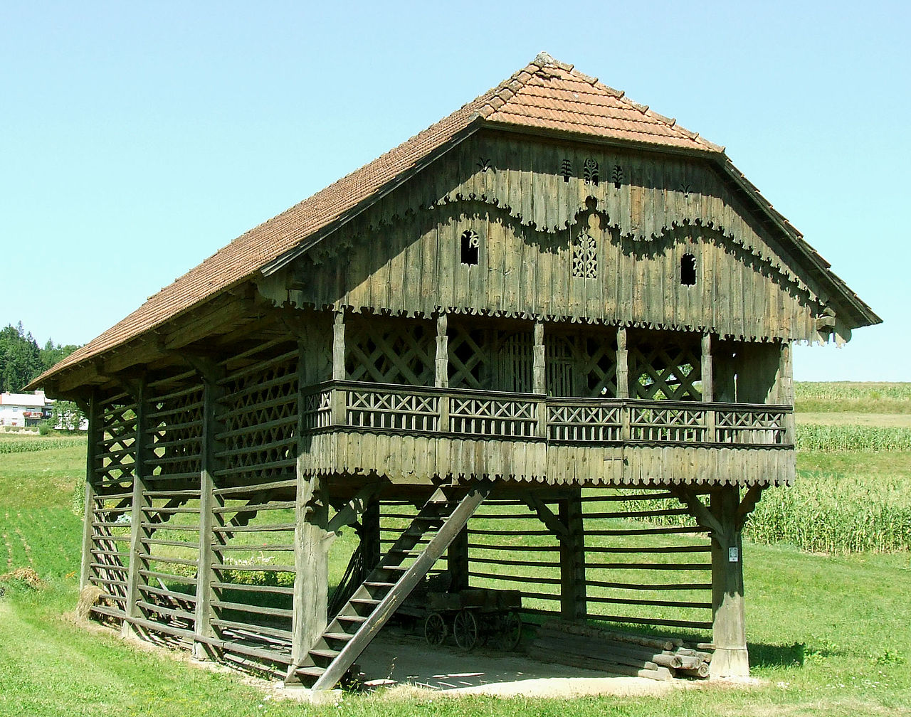
Kozólec je lesena, s strani odprta stavba za sušenje žita in trave.
A hayrack is a wooden structure used for drying cereals and hay.
Kozolce prepoznamo po latah – prečnih tramovih.
It is recognized by crossbeams.

Slide 3
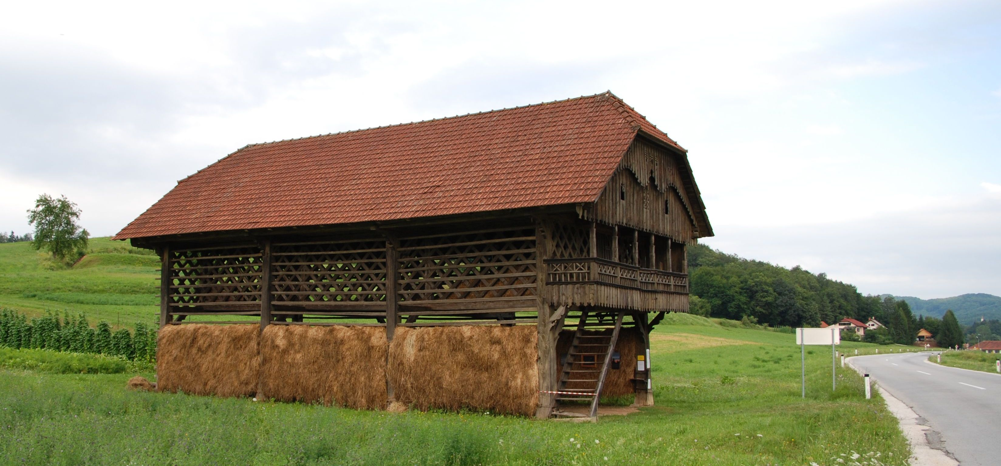
Kozolec je namenjen sušenju trave.
It is used for drying grass.

Slide 4
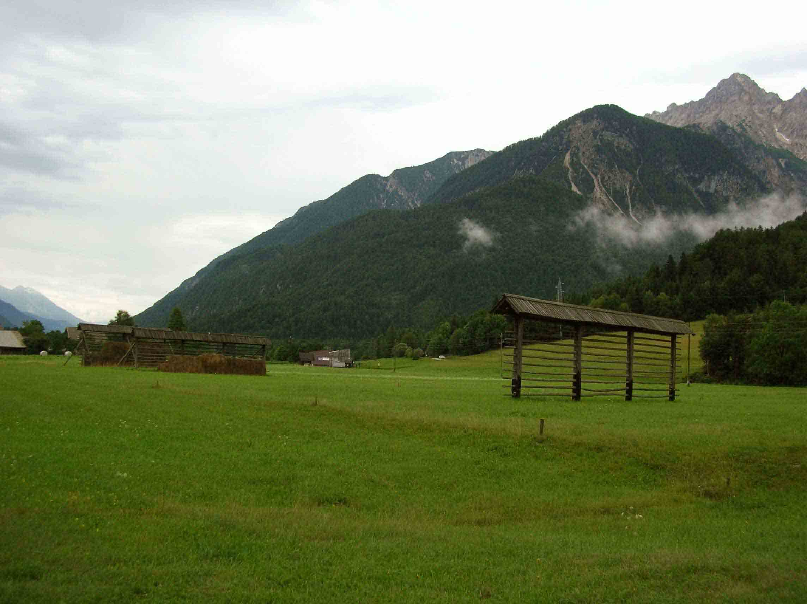
Kozolci so zelo značilni
za slovensko podeželje
in arhitekturo.
Hayracks are typical
of Slovenian countryside
and architecture.

Slide 5
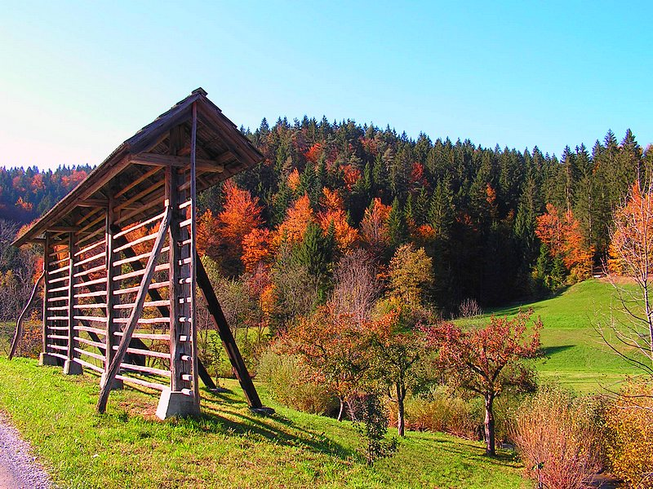
DVE VRSTI KOZOLCA
TWO TYPES OF HAYRACKS
Dvojni kozolec Enojni kozolec
A double hayrack A single hayrack

Slide 6
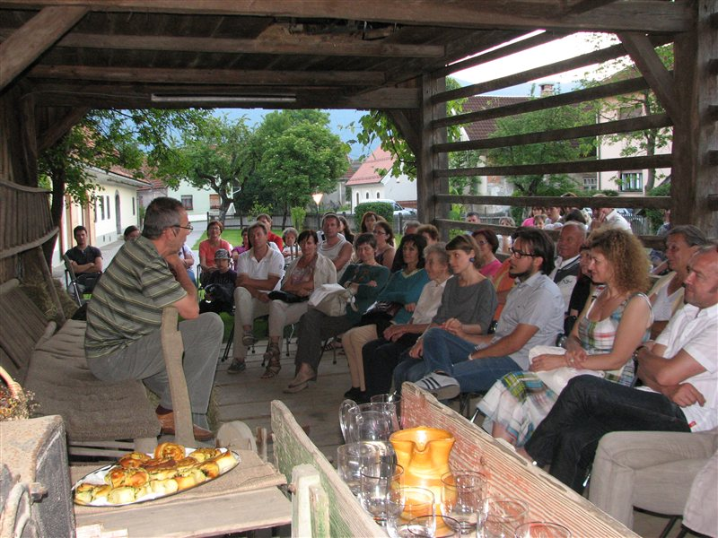
Danes, v času modernega kmetijstva, se kozolci uporabljajo bolj za prireditve in veselice.
Nowadays, in the age of modern agriculture, hayracks mostly host
different types of events and parties.

