Slide 1
SLOVENE PEASANT REVOLT 1515
Introduction:
More than 500 years ago in 1515 there was a Slovene Peasant Revolt, the largest peasant revolt in the area of Slovenia. The subordinate peasants rose up against their landlords but they were defeated.

Slide 2
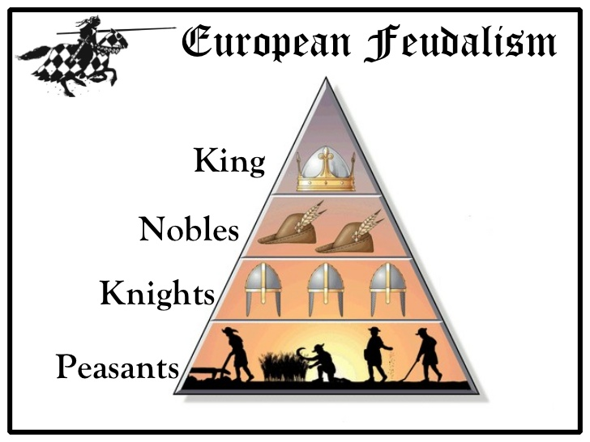
Well, let's start from the beggining.
In the Middle Ages there were two classes of people:
NOBLES: from king to knights
PEASANTS (90%).

Slide 3
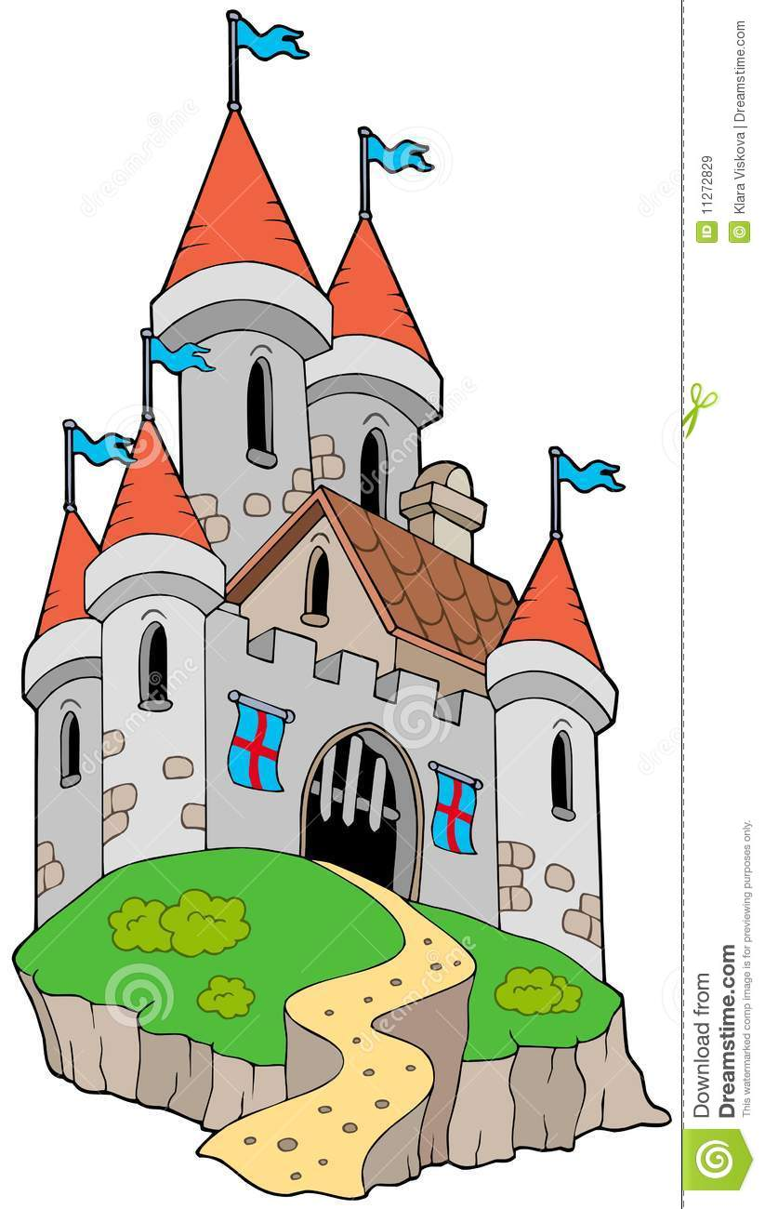
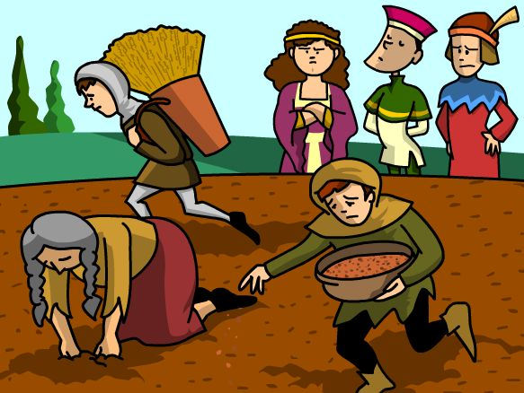
The nobles were very rich, they lived in castles and owned all the land.
The land was farmed by peasants, who had to give half of their crops as a rent to the landlords.

Slide 4
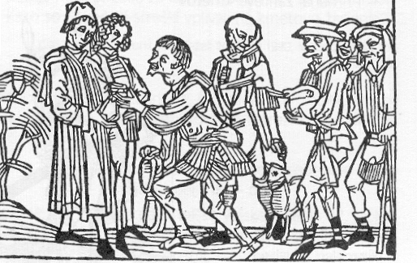
2. In the 15th century the nobles demanded a higher share of the peasants' crops. As a result the peasants had fewer crops for themselves and their families were starving.
3. Several times the peasants politely asked their landlords to reduce the taxes, but the landlords turned a deaf ear to their pleas.

Slide 5
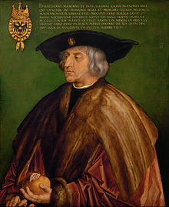
4. They did not know what to do.
Therefore they asked Emperor Maximilian I. for help. He was the ruler of all the people in the country and he promised to help.
The Emperor Maksimilian I. (1459-1519)

Slide 6
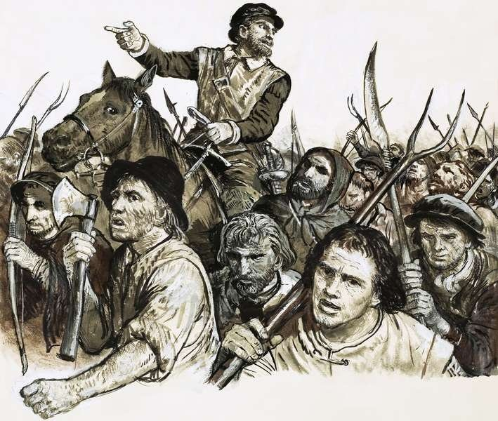
5. The peasants were encouraged by the emperor's promise.
They attacked the castles throughout the country.
They were not armed so they took pitchforks, scythes and rakes.

Slide 7
6. There was a great bloody battle between the peasant armies and the nobles. There were lots of peasants but the nobles were well armed, they had swords, sabres and armours. They were knights with fighting skills.

Slide 8

7. The peasants were losing the battle . They were expecting the emperor's army to help them. But the army did not arrive.

Slide 9
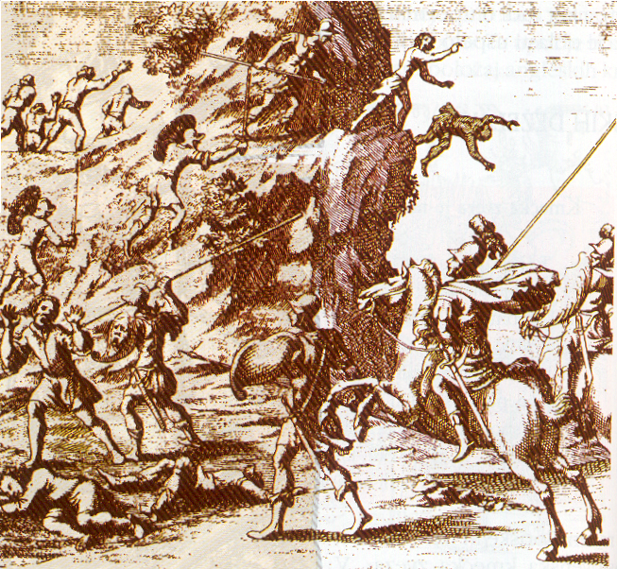
8. Then the army finally arrived but took the side of the nobles!
In the end the poor peasants were betrayed. The emperor's and nobles' army came together and defeated the peasants.

Slide 10
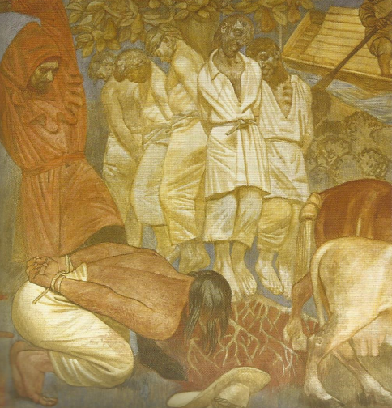
9. THE END
The defeated peasants were severely punished by the nobles.
They had to pay even more taxes and their leaders were killed.

